Slide 1
Image Classification Model
in
WASTE MANAGEMENT
Group 1
Jeff, Kurtis, Lois & Oillio
Nov 2020

Slide 2

0 1
Project Aim
02
Business Value
Evaluation and Prediction
03
DataSet and Model Creation
04
Conclusions
Code Explanation
05
06
07
Challenge & Next Steps
08
Q & A

Slide 3
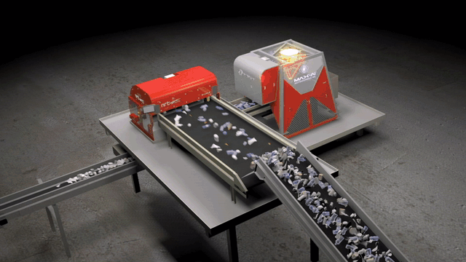
PROJECT AIM
Aim:
Train a model to see the way as human with Deep Learning.
Combining the use of robotic arms to classify waste effectively without days off.
Recycle the waste as much as possible to give a better environment.
Waste Crisis:
The world bank report in 2016 estimated that wastes will jump up 70% to 3.4 billion tonnes a year in 2050 due to population growth and urbanization.
Plastic is the most toxic one in waste which is damaging our ecosystems.
Effective waste management is 20%-50% more expensive in comparing with dumping into landfill.
Waste is not properly classified during collecting process, ending up in landfill rather than recycled.

Slide 4
BUSINESS VALUE
01
03
Technology
Recyclability
Using AI (deep learning) & robotic arms
02
Recycle waste as much as possible
04
Efficiency
Sustainability
Classify waste effectively (24hrs a day)
Maintain a sustainable environment for living

Slide 5
DATASET and MODEL CREATION
Sources:
https://www.kaggle.com/asdasdasasdas/garbage-classification (2500 images)
Images download from google (3500 images)
All images are then converted into JPG files
Delete the crashed image files
Dataset is divided into classes as cardboard, glass, metal, paper, plastic and trash

Slide 6
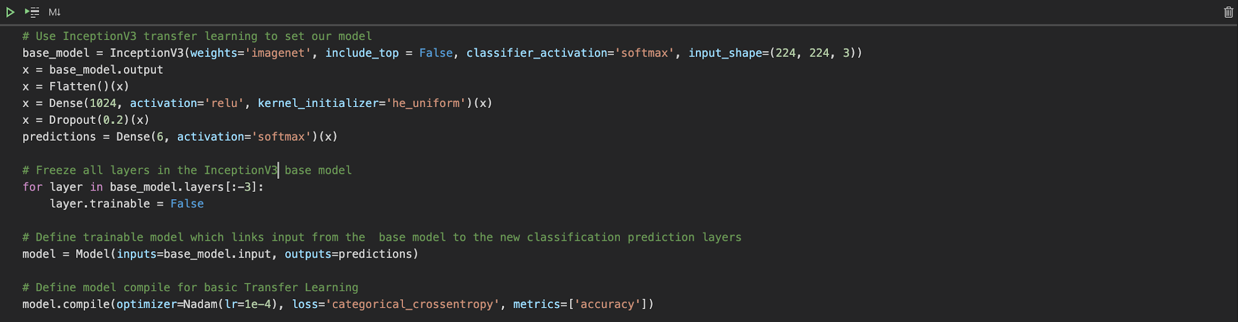
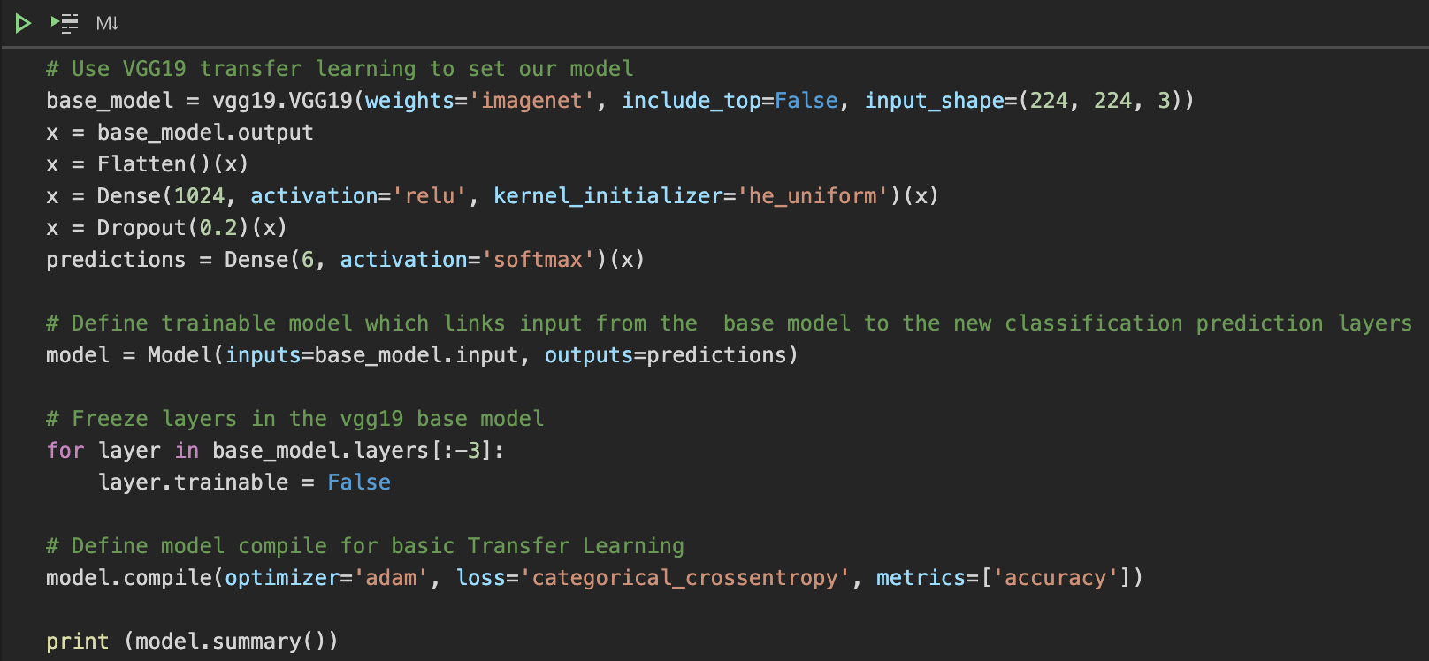
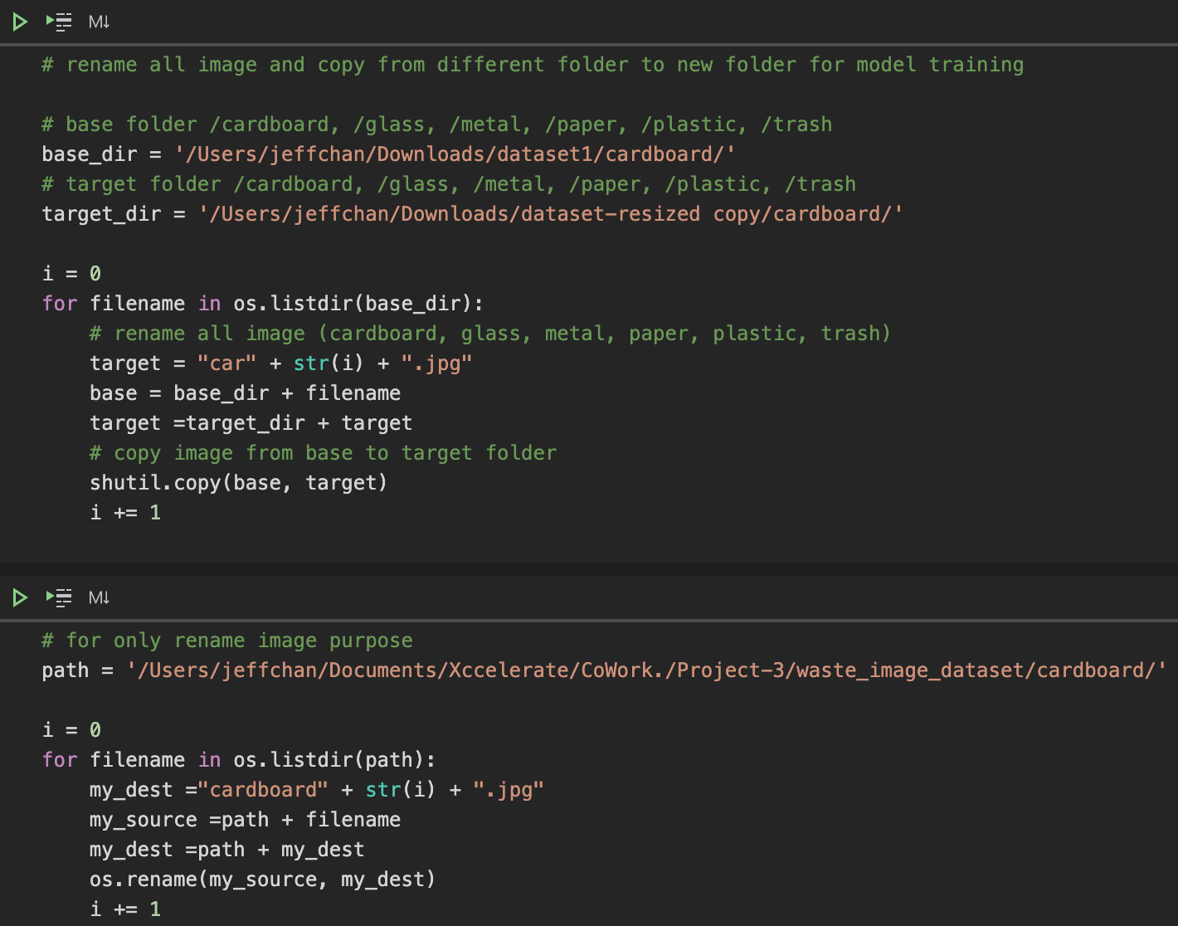
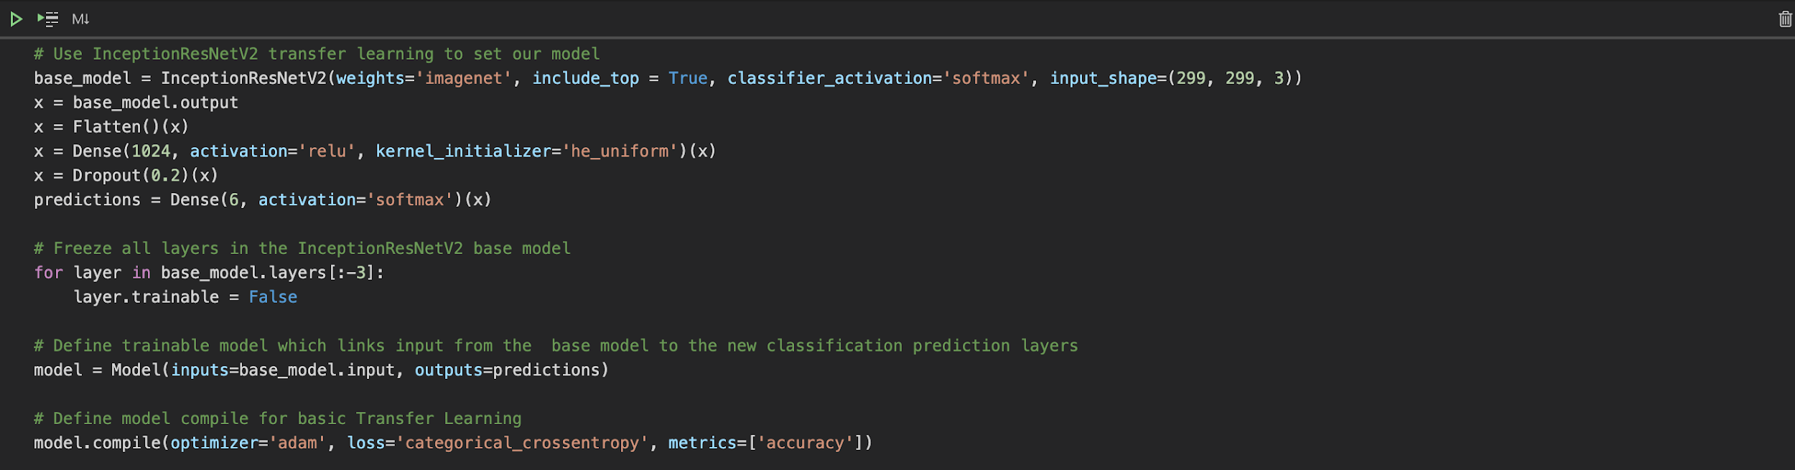
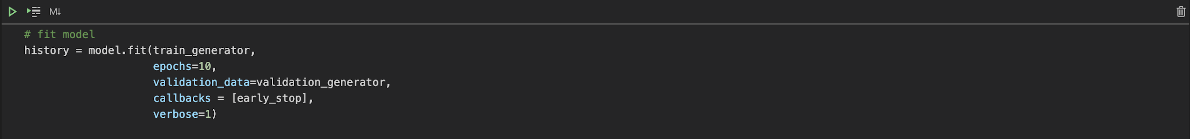
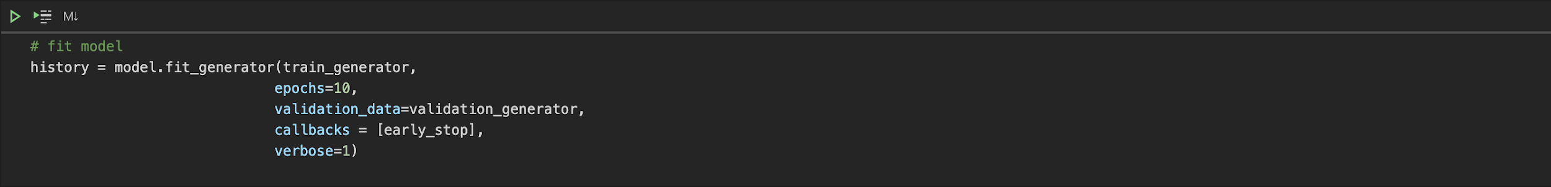
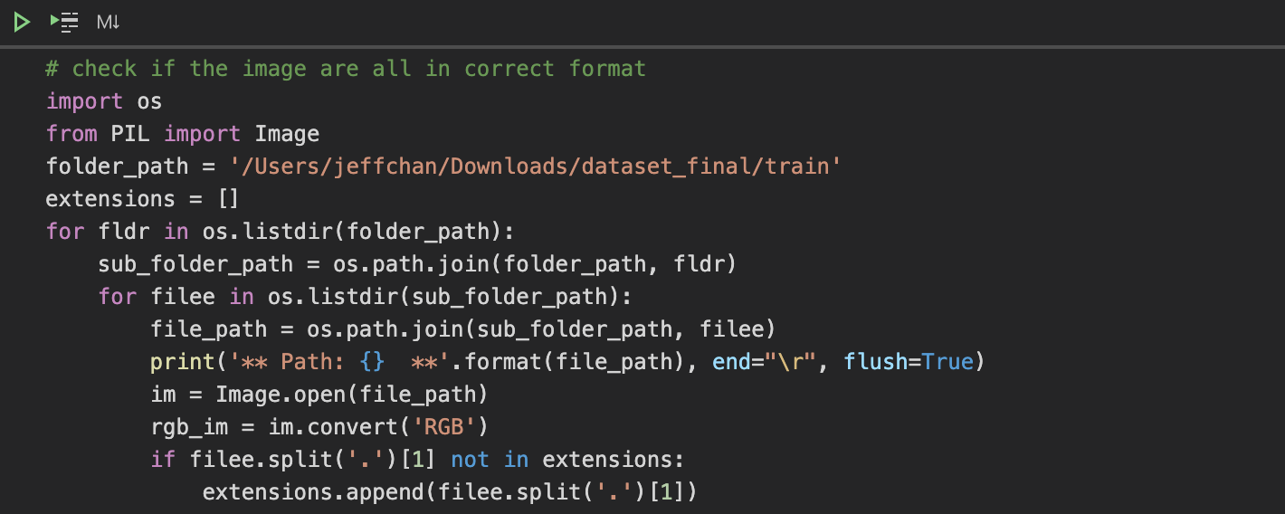
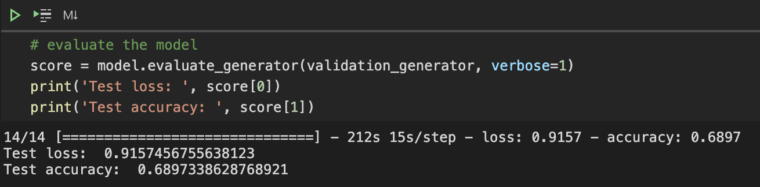
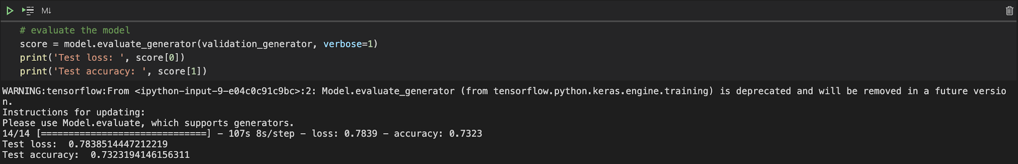
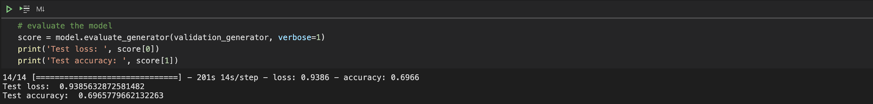
Model Creation:
Pretrained Model adopted
InceptionV3
VGG19
preprocessing
InceptionResNetV2
Notes:
Preprocessing: org: ard 2500 → not enough → find some more on the internet
Rename all photos in numerical order in order to find out the position of any crashed photo in next stage

Slide 7
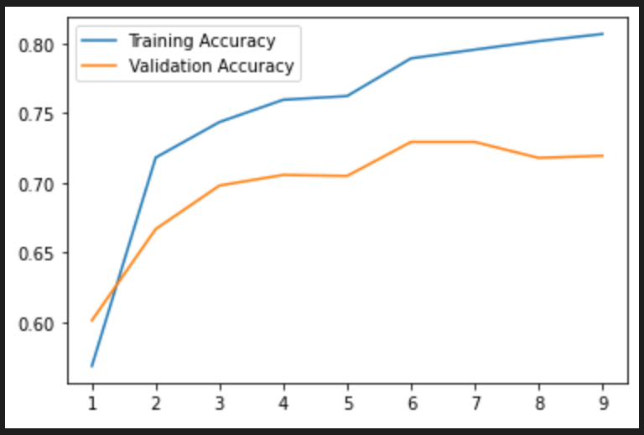
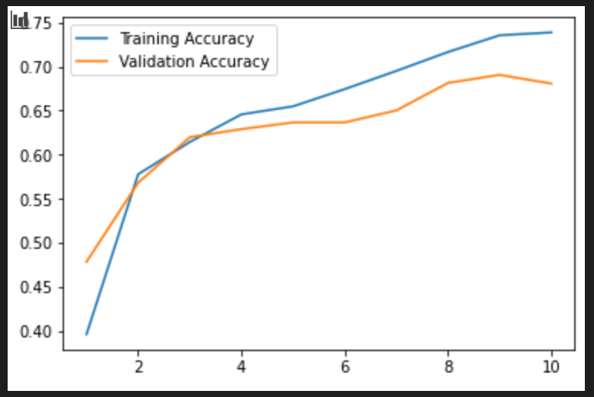
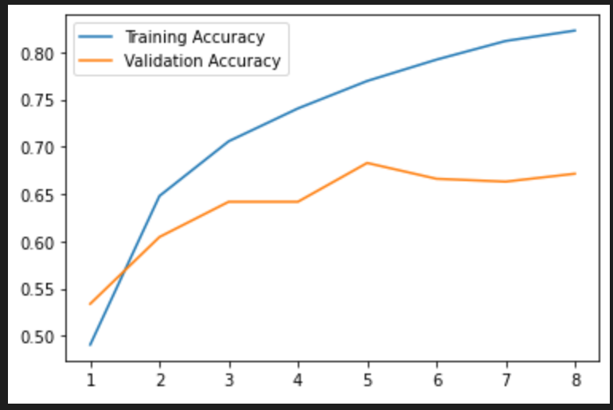
EVALUATION and PREDICTION
InceptionV3
InceptionResNetV2
VGG19
Notes:
Overall trend: increase
Training accuracy for models are around 80%
Splitting point from training and validation accuracy for: V2 & V3: at 0.63; VGG19: at 0.57
Distance between training and validation: VGG19: 0.15; V3:0.1; V2: 0.05 (shortest distance)
However, accuracy of VGG19 is the highest

Slide 8
Percentages of Accuracy (validation)
Inception
ResNetV2
Inception
V3
69.6%
71.9%
VGG19
68.9%
Notes:
Inception v3 → V2 → vgg19

Slide 9
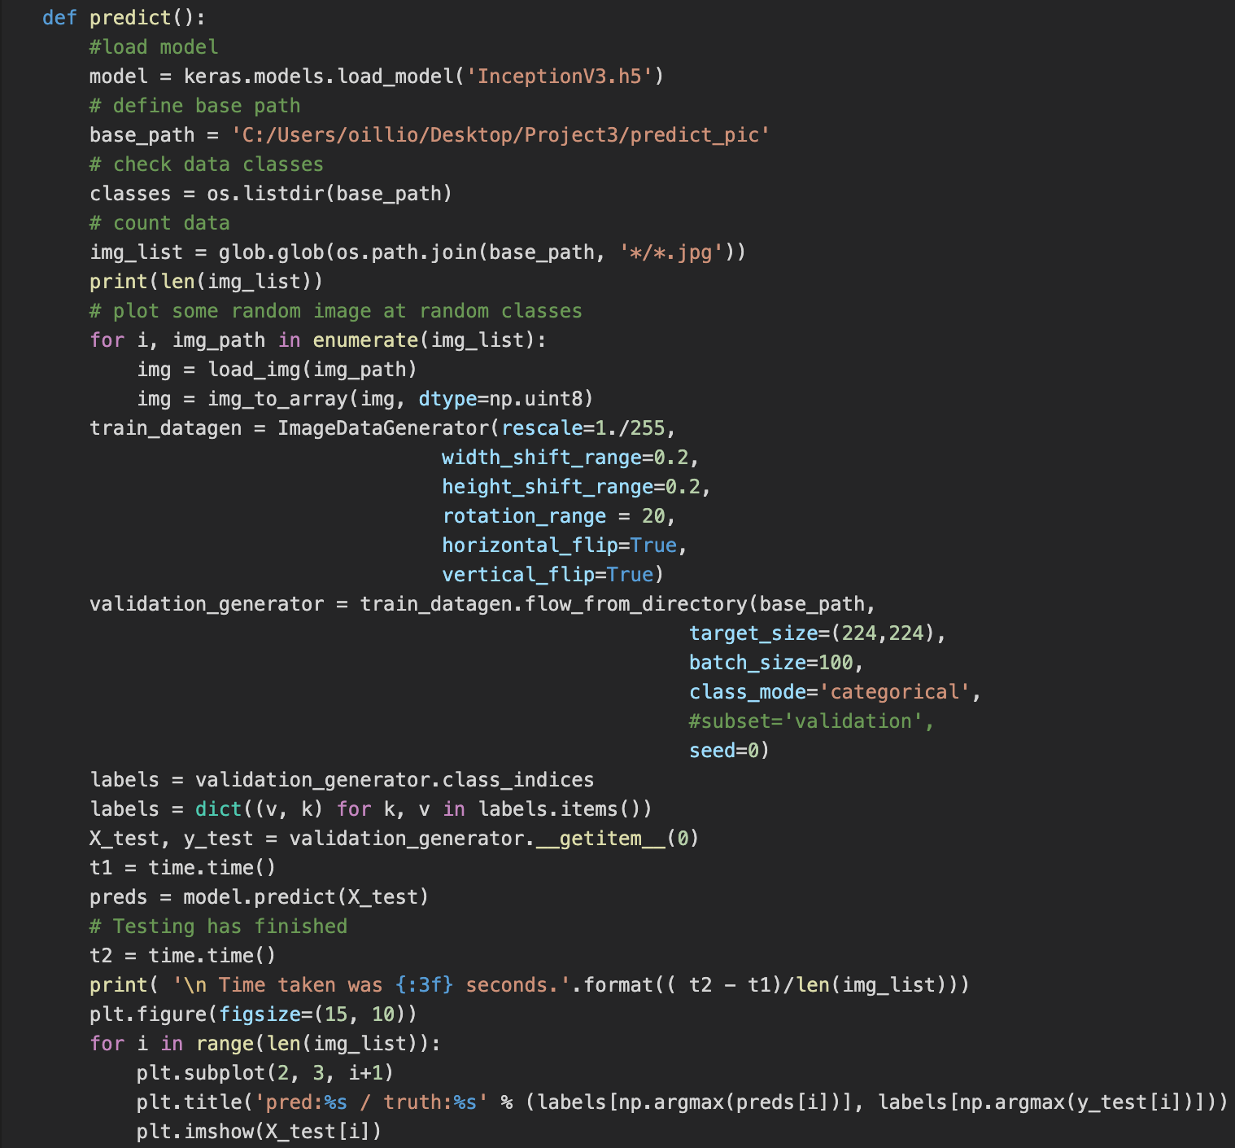
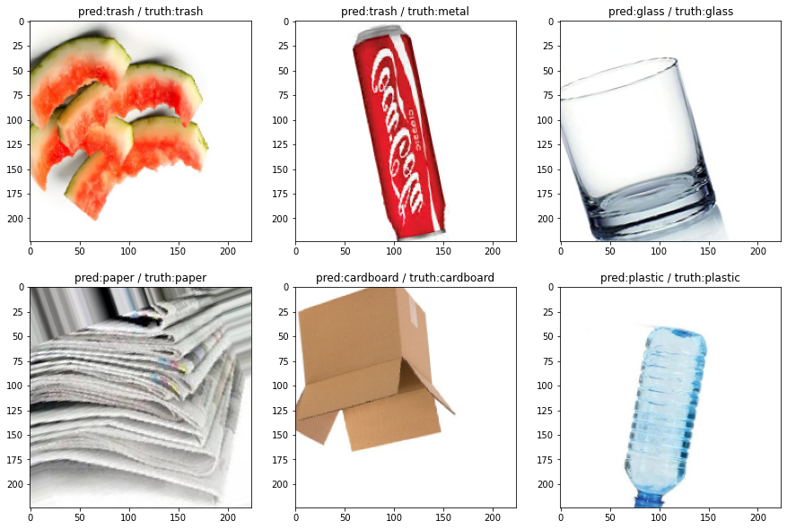
Prediction
Randomly get some photo from google and test our model
Notes:
Most of them are correct except the cocacola can. It is incorrectly predicted as trash but it should be identified as metal.
Reason: Maybe color of the can and glare of the can
As from our training data, most of them are in silver color and most of them have the light reflection on the can. However, this cocacola can is in red and lack of glare.
Therefore, Importance of choosing photos as training data should be aware of.

Slide 10
CONCLUSIONS
High Accuracy - InceptionV3 model can recognize the images with accuracy as high as 71.9%.
01
02
High Efficiency - 96 images can be processed in a minute.
High Recyclability - model can properly identify the most toxic material “Plastic” to recycle.
03
Better Environment - more waste can be recycled and reused, a more sustainable environment to live on.
04
Notes:
From our models, We have high accuracy and high efficiency
We hope the model counld increase Recyclability
And have a better environment

Slide 11
CODE EXPLANATION

Slide 12
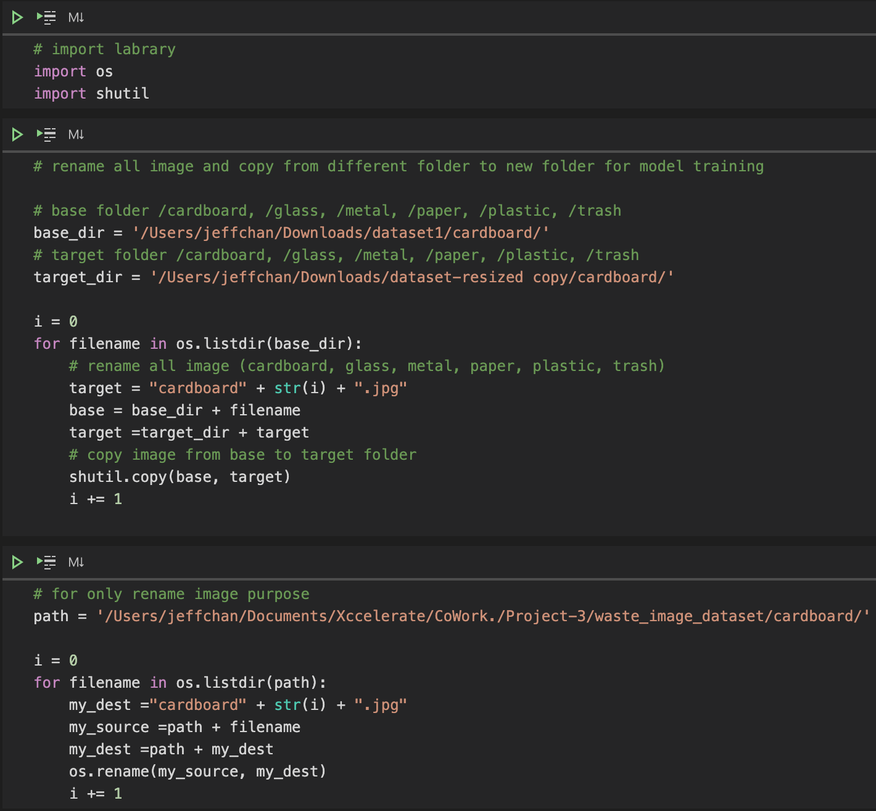
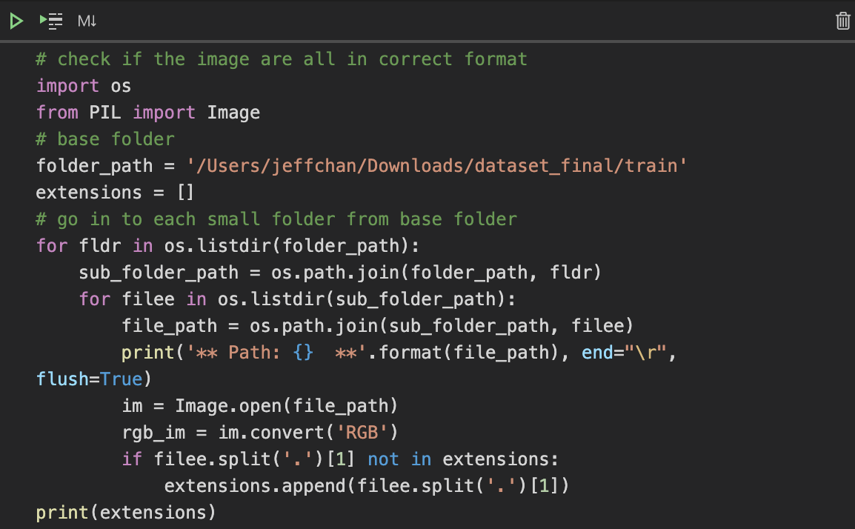

Slide 13
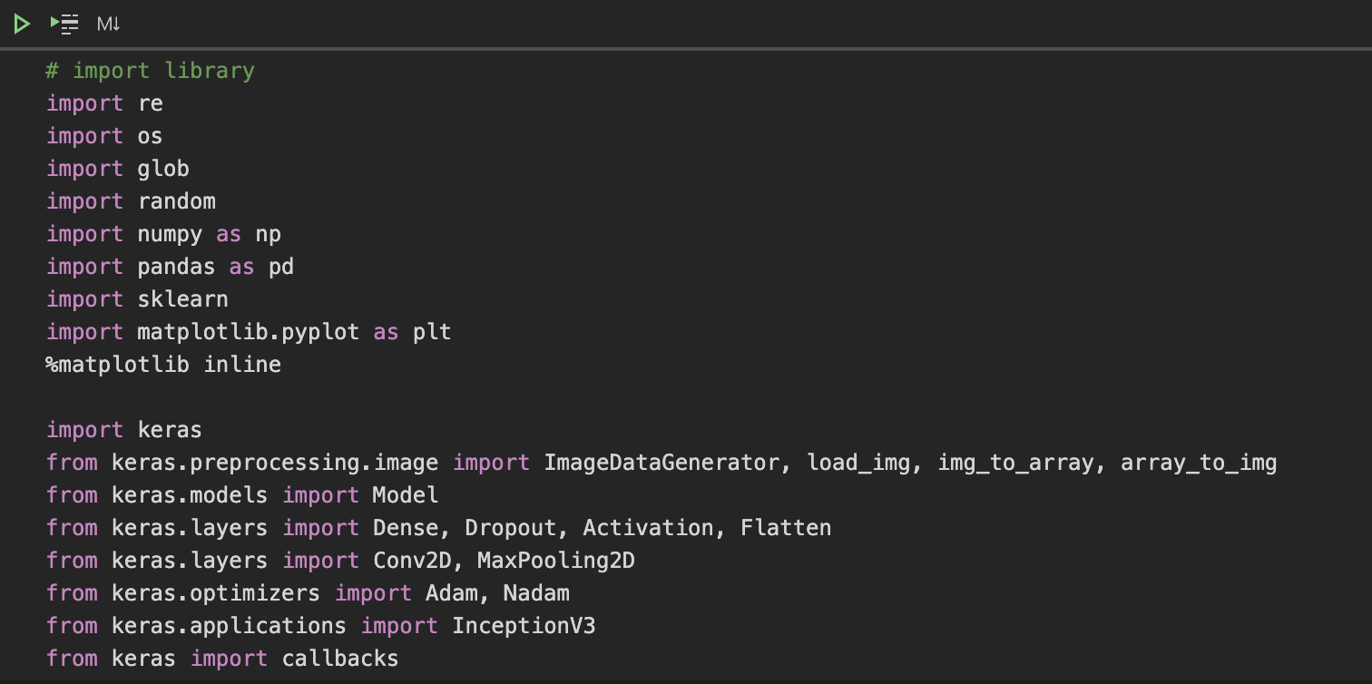
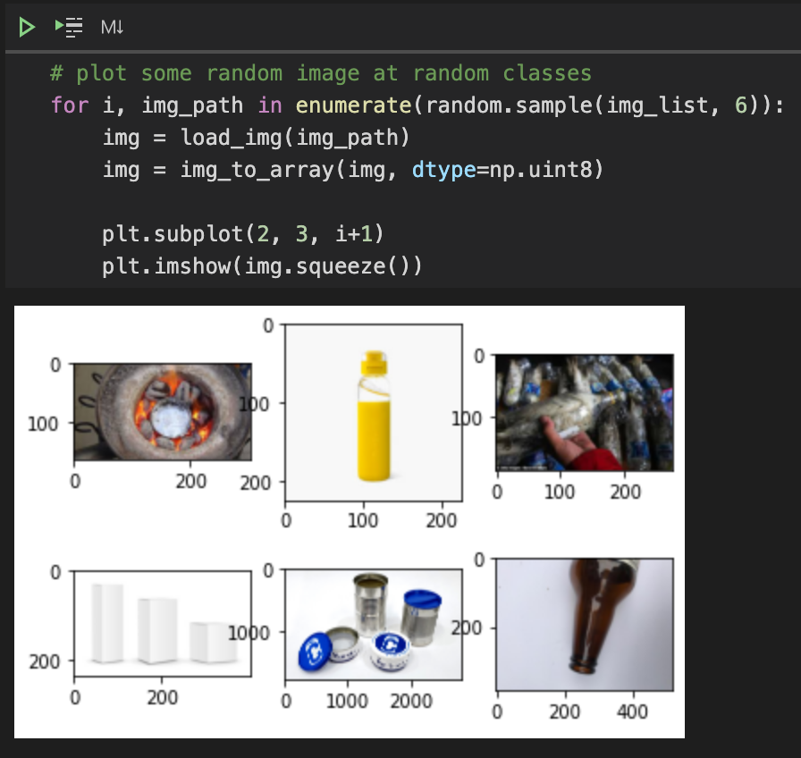
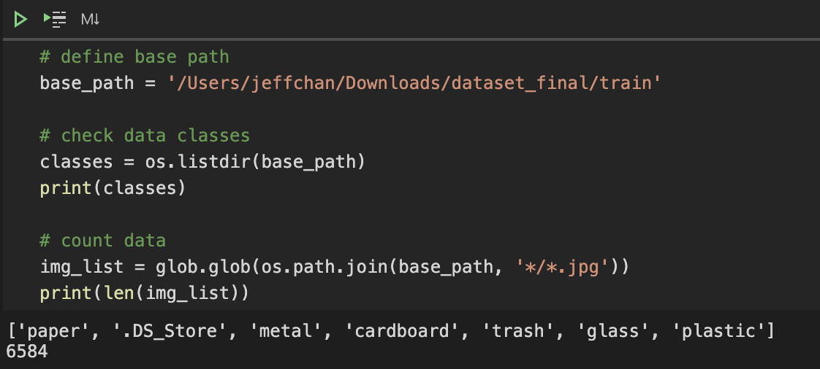

Slide 14
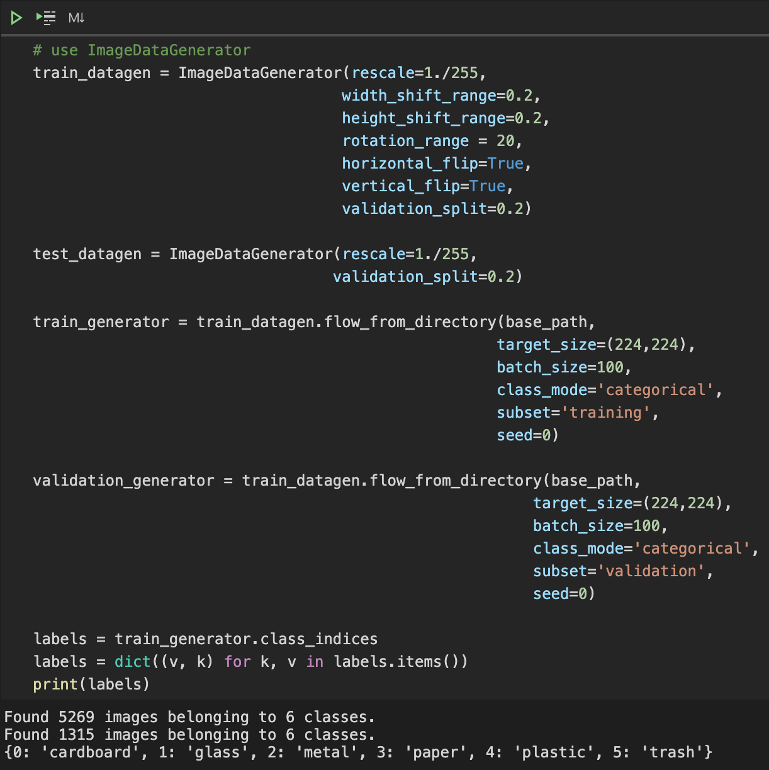
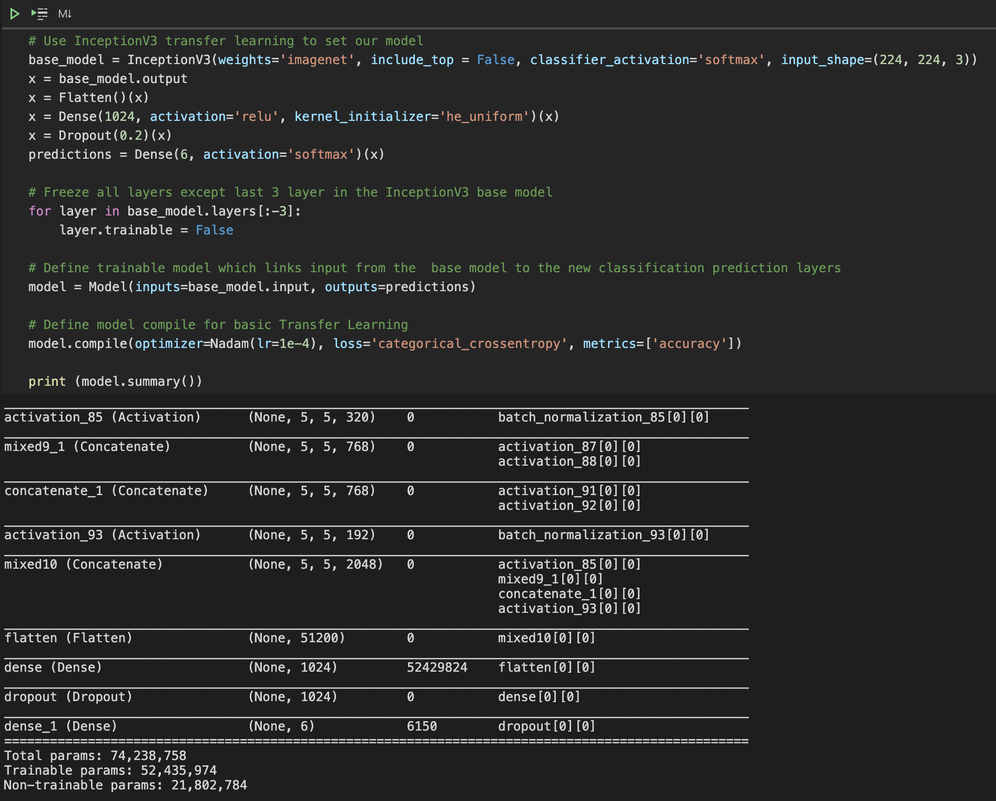
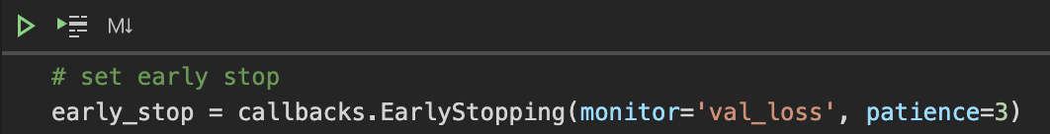
Notes:
Data orienation

Slide 15
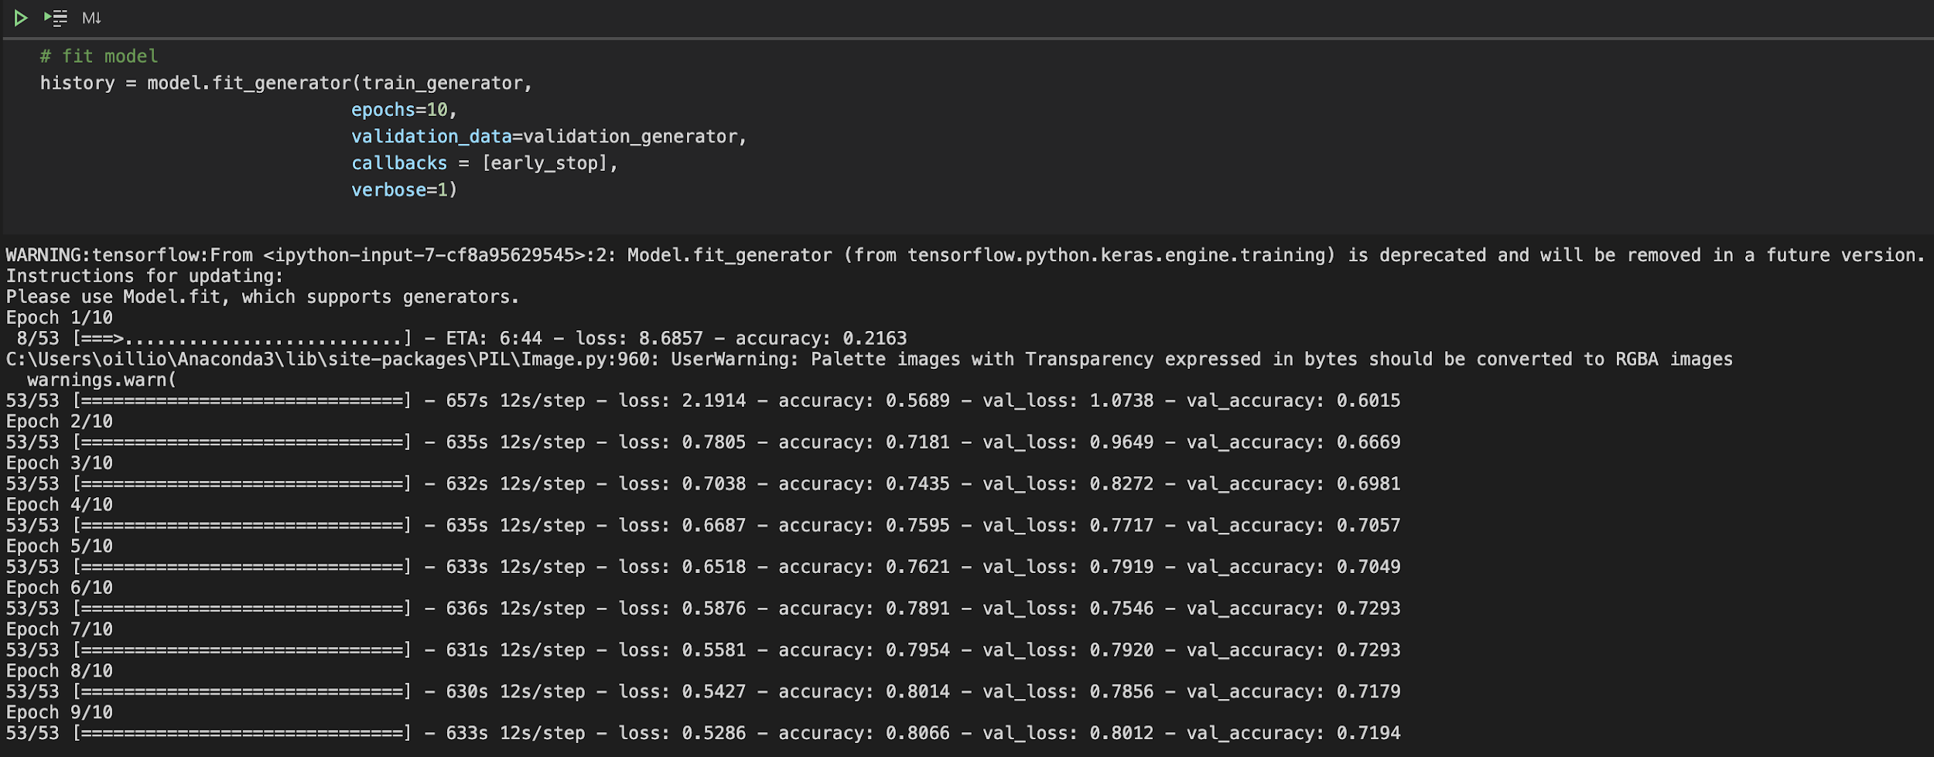
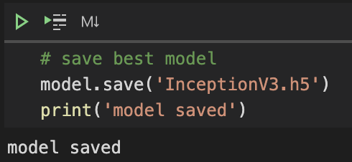
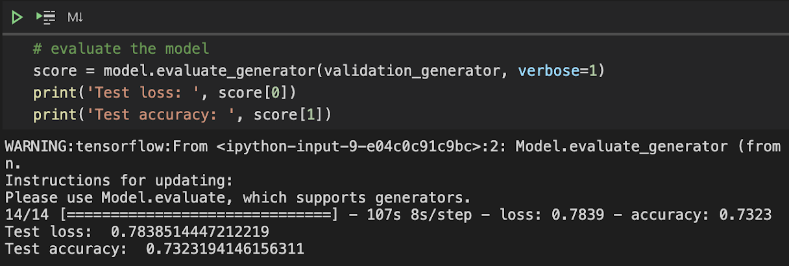

Slide 16
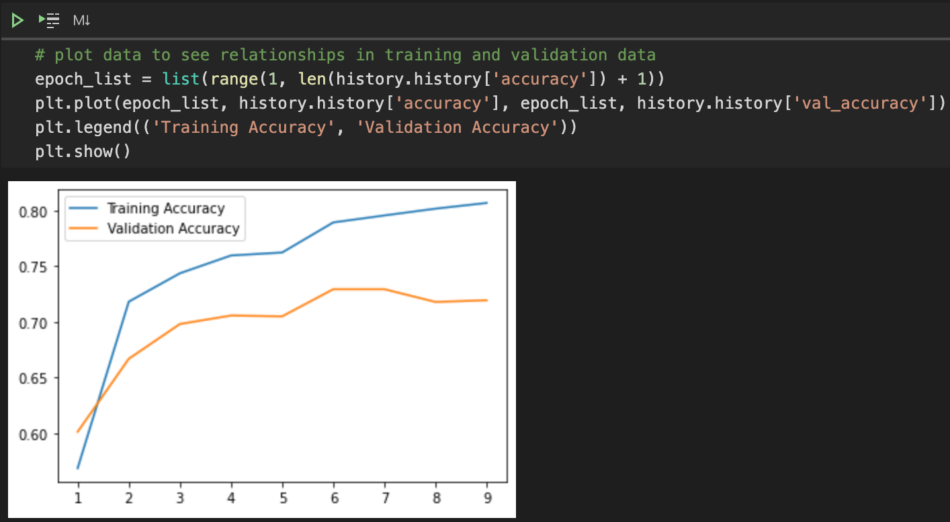

Slide 17
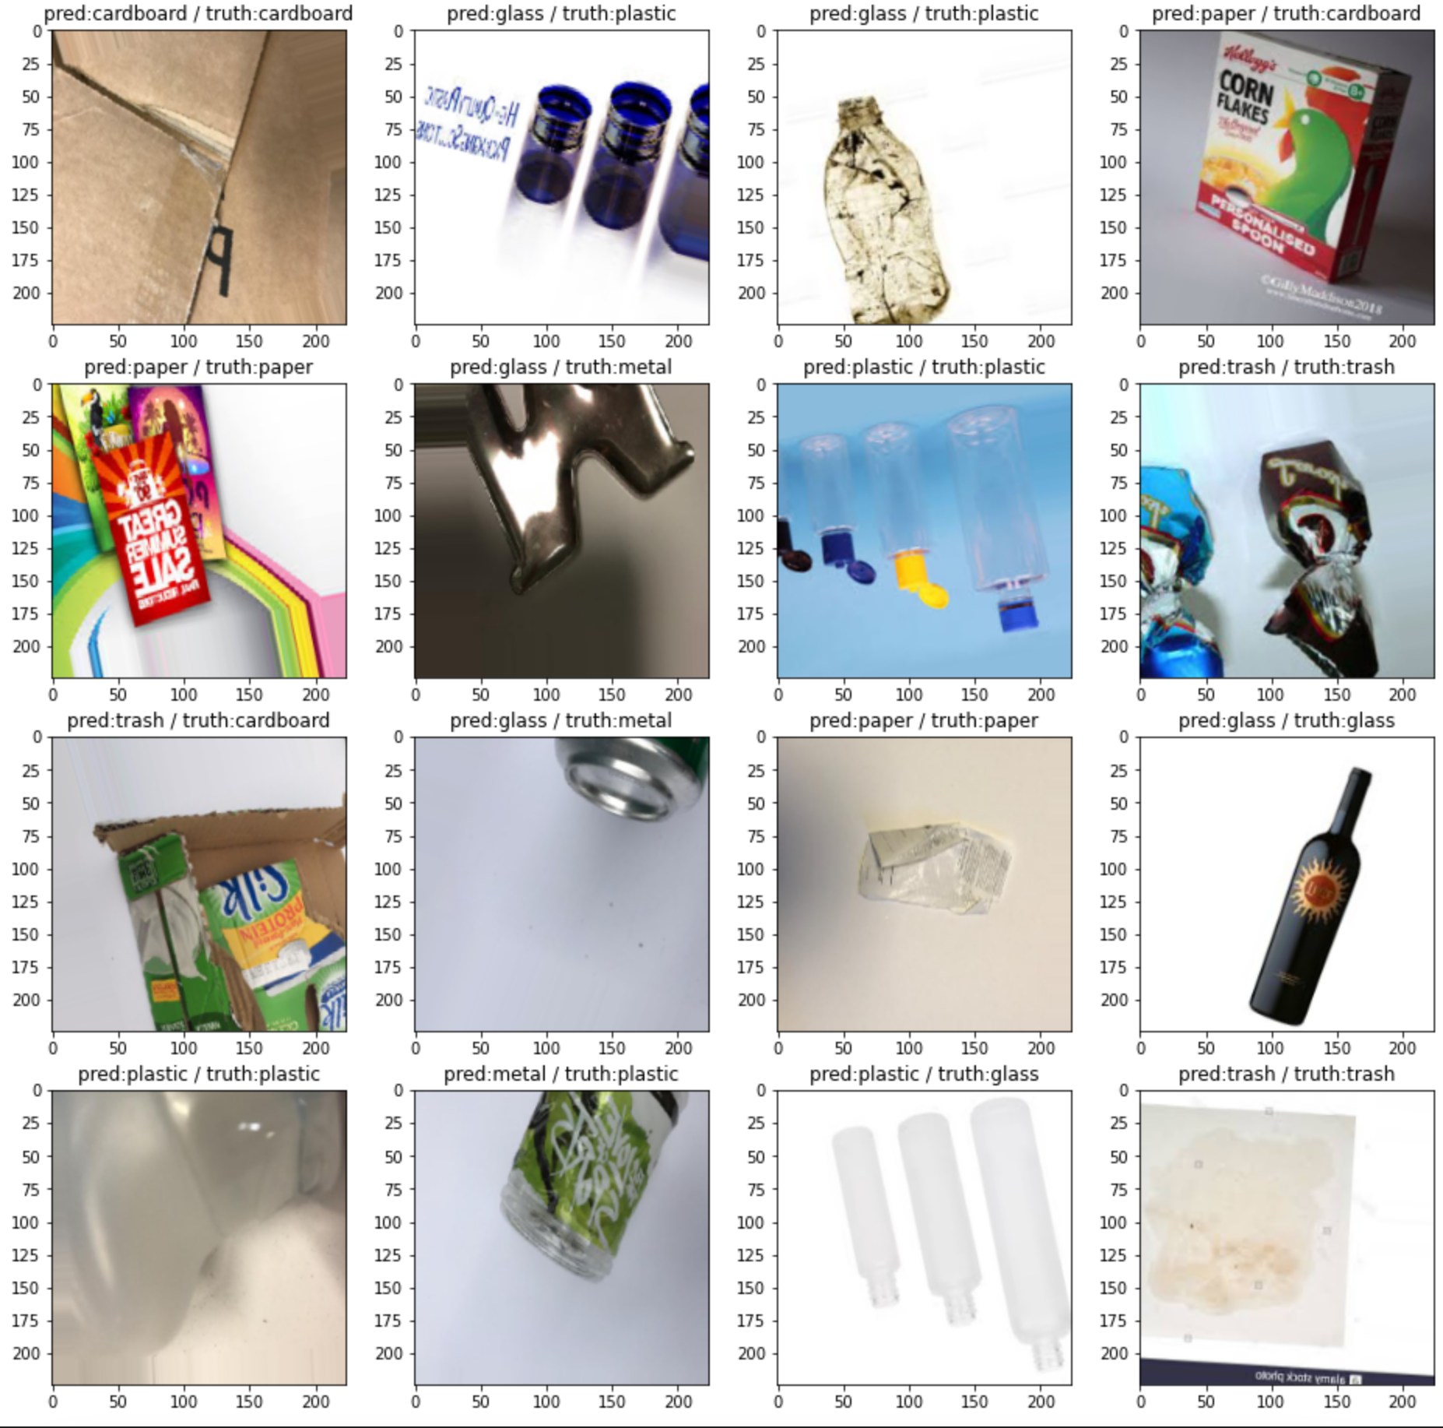
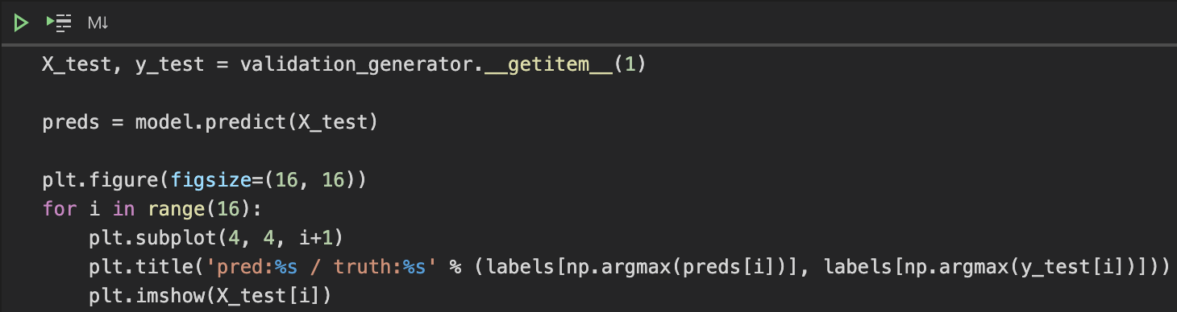

Slide 19
CHALLENGES and NEXT STEPS
Challenges
Image processing
Photo formatting (need to convert different types of image format).
Crashed images found during data collecting stage.
Large variation in the images resolution.
Model creation and evaluation
Unable to adopt more than 20 different keras applications in limited time.
Certain of time is required for each model training
Limited Computational Power

Slide 20
CHALLENGES and NEXT STEPS
Next Steps
Tunning
Use more ‘nice’ pictures to train(high PPI)
Hypertunning parameters by
Use GridSerachCV with different parameters
- E.g. optimzer, epoch, batch, learning rate,
- Add more dense/ layer to improve accuracy
Innovative idea
Add More devices to help identify models (e.g.sensor).
3D image Models???
Adopt robot as trashbot for collecting waste in street???

Slide 21
Q & A
Do you have any questions?

Slide 22
Thank you

